Slide 1

RUDHIRA DHAAN
“Donate blood, save lives-faster and easier than ever before”
Notes:
ID=d924773e-9a16-4d6d-9803-8cb819e99682 Recipe=text_billboard Type=TextOnly Variant=0 FamilyID=AccentBoxWalbaum_Zero

Slide 2

Problem Statement
Over 12,000 persons die every day in India due to non-availability of blood
According to WHO, for every 1,000 people in any country, at least 10-20 donors are required to provide adequate supplies
The traditional methods of donating blood are often inconvenient and discourage people from donating.
Availability of required blood in emergency situations
Lack of an organized and accessible system for donating blood that can quickly respond to emergency requests
https://www.istockphoto.com/photos/blood-donation
https://timesofindia.indiatimes.com/blogs/voices/blood-donation-saves-lives/

Slide 3
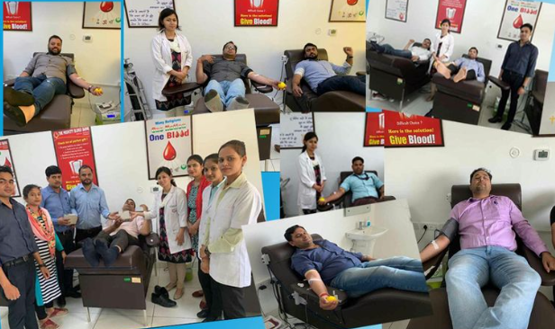
Customer Segment
Hospitals and medical centers that require a steady supply of blood for emergency situations
Individuals who require blood transfusions during medical procedures
Blood donation centres that need to increase their blood base
People who lived in remote areas where access to blood donation centers is limited
Those who are unable to travel to blood donation centers due to special needs
People who hesitate to donate blood for their traditional beliefs
Ref: https://images.app.goo.gl/ekGjjt8cP2XGbf7k8

Slide 4
Customer Survey
Survey Size: 50 and ongoing
Sample survey questions:
Have you ever donated blood before ? If so , how often you donate?
What are some of the reasons why you donate blood?
What are some of the challenges you face when donating blood?
How would you prefer to be notified about emergency blood donation requests?
What are some of the features that you would like to se in blood donation platform?
How likely are you to use a blood donation platform that is convenient and easy to use?
What are some of the concerns or questions you have about donating blood?
What are some of the incentives that would motivate you to donate blood more frequently?

Slide 5
Survey Result for Questions 1 to 4:
Percentage of Responses
calls from friends and relatives and hospitals
support a cause
get some money
not having much transport facilities
lack of time
don’t know the eligibility criteria
help others
don’t know their blood group
text message
social media
To feel good
YES
NO
email
Survey Question Number

Slide 6
Survey Result for questions 5 to 8 :
Percentage of Responses
Real time updates on blood availability
personalisation donation schedules
Eligibility criteria
yes
safety
Side effects
Social impact
recognition
no
rewards
Survey Question Number

Slide 7
Customer Survey
Customer Survey Outcome:
1.Limited awareness or understanding the importance of blood donation: Some respondents not fully understand the significance of donating blood or may have misconceptions about the process.
2.Inconvenience or lack of accessibility: Respondents find it difficult to donate blood due to various reasons such as lack of time , difficulty in finding donating centre, lack of transportation facilities , don’t know their blood group.
3. Communication barriers: Respondents prefer different communication channels and not be reachable through certain channels , making it challenging to notify them about emergency blood donation requests.
4.Motivation and incentives: Respondents require different incentives to motivate them to donate blood more frequently , which can make it challenging to create a system that appeals to every one

Slide 8
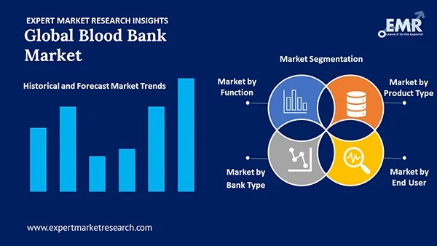
Market Size:
Market Analysis
Expected growth rate(CAGR): global blood bank market research
The market is anticipated to grow at a CAGR of 4.7% during the forecast period of 2023-2031 to attain a value of USD 25.4 billion by 2031
The major product types of blood banks are:
Whole Blood
Red Blood Cell
Platelet
Plasma
White Blood Cell
The market can be broadly on the basis of its functions into:
Collection
Processing
Testing
Storage
Transportation
On the basis of end users, the market :
Hospital
Ambulatory Surgery Centers
Pharmaceutical Companies
Clinics and Nursing Homes
Reference: https://www.expertmarketresearch.com/files/images/global-blood-bank-market-by-segment.webp

Slide 9
The blood bank information systems market is projected to reach US$ 1,103. 95 Million by 2028 from US$ 659. 87 Million in 2021; it is expected to grow at a CAGR of 7. 6% from 2021 to 2028.
Further, increasing hematologic diseases are the second-leading cause of the rising demand for blood.
According to WHO (World Health Organization), approximately 118.4 million blood donations are collected globally, out of which 40% are collected in high-income countries
The highest growth of voluntary unpaid blood donations is witnessed in the Regions of America with 25% and 23% in Africa. Thus, the above mentioned factors fuel the demand for blood bank information systems market growth.
source: https://finance.yahoo.com/news/blood-bank-information-systems-market-121800180.html

Slide 10
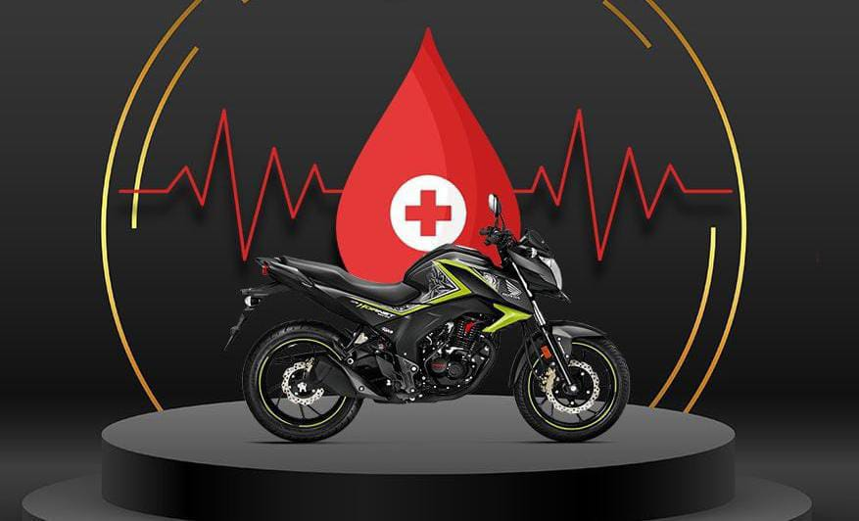
Potential Solution:
Developing a mobile app that make it easy for donors to schedule appointments, track their donations , and receive notifications about upcoming blood drives
By using bikes to pick up and drop off donors, our project could potentially provide a faster and more efficient way to transport blood to hospitals and other medical facilities
Using social media and other marketing channels to raise awareness about the importance of blood donation and encourage people to get involved
Building partnership with hospitals clinics, and other healthcare providers to ensure a steady supply of blood and other medical supplies

Slide 11
Competitor Analysis:
Competitors globally :
American red cross - https://www.redcross.org/
Blood works Northwest - https://www.bloodworksnw.org/.
Zipline - https://techcrunch.com/2022/12/15/zipline-is-now-the-national-drone-service-provider-for-rwanda/ .
Uber Health - https://www.uberhealth.com/.
rotatory blood bank: https://rotarybloodbank.org/?
National Blood Transfusion Council http://nbtc.naco.gov.in/
Technical Comparison:
Donor engagement: Focused on providing convenient and efficient way for blood donors to donate blood during emergencies .while established donation services , they typically have a broader focus on engaging donors for regular, ongoing donation.
Focusing on more complex and integrated systems for managing donor data, tracking donations, and coordinating blood delivery
Focusing on a specific niche of emergency blood donation services.
Establish partnership with hospitals , clinics, and emergency responders to provide on-site donation services and coordinate blood delivery during emergencies.

Slide 12



Road Map
Our idea has been initiated in May 2023
May -July
Conduct customer survey and market research
August
Proof of Concept Development(PoC)
September-November
Launch a pilot program in a specific geographic area and collect feedback.
December-February
Expand the pilot program and continue to collect feedback.
March-May
Develop an app or website and launch to the public.
Conduct ongoing user testing and feedback, and develop a plan to recruit additional donors and expand to new geographic areas.
June-August

Slide 13
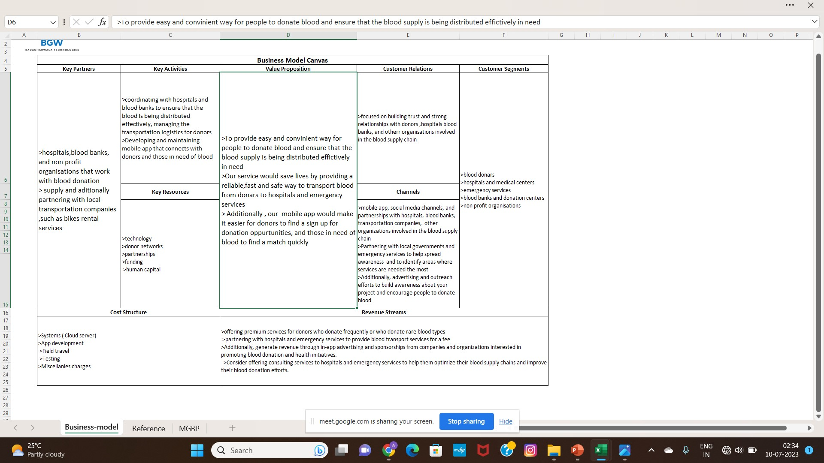
Business Model:

Slide 14

Prototype:
Mobile application that allows to donors to sign up for our service.
Admin : Responsible for processing data and handling main dashboard authentication
Main dashboard: handling all user inputs like donor logins and customer requests
Schedule donation appointments, and track the status of their donations.
We also include features like real-time tracking to donors to know about their safety.
Notifications to alert donors and hospitals when blood has been delivered.
https://www.freepik.com/vectors/notification-concept/37

Slide 15
Prototype Development Cost:
Factors | Cost in rupees
1. Systems ( Cloud server) | 2,00,000
2. App development | 75,000
3. Field travel | 50,000
4. Testing | 2,00,000
5. Miscellanies charges | 75,000
TOTAL | 6,00,000

Slide 16
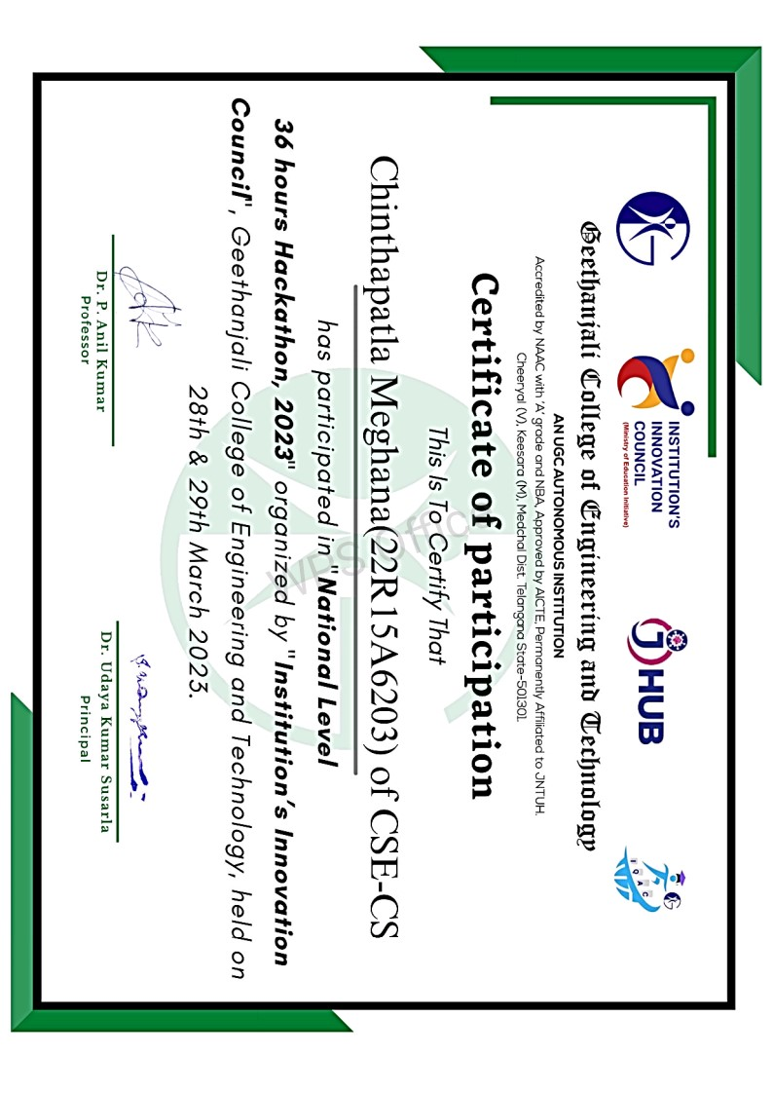
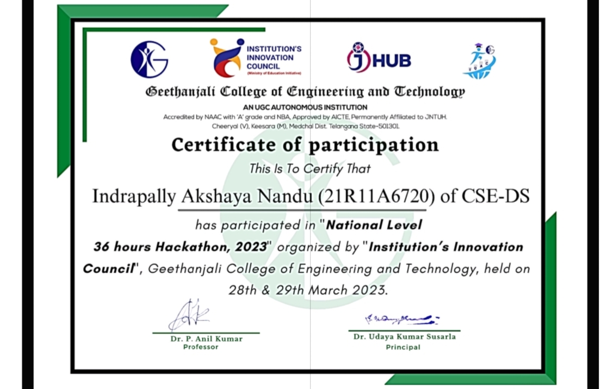
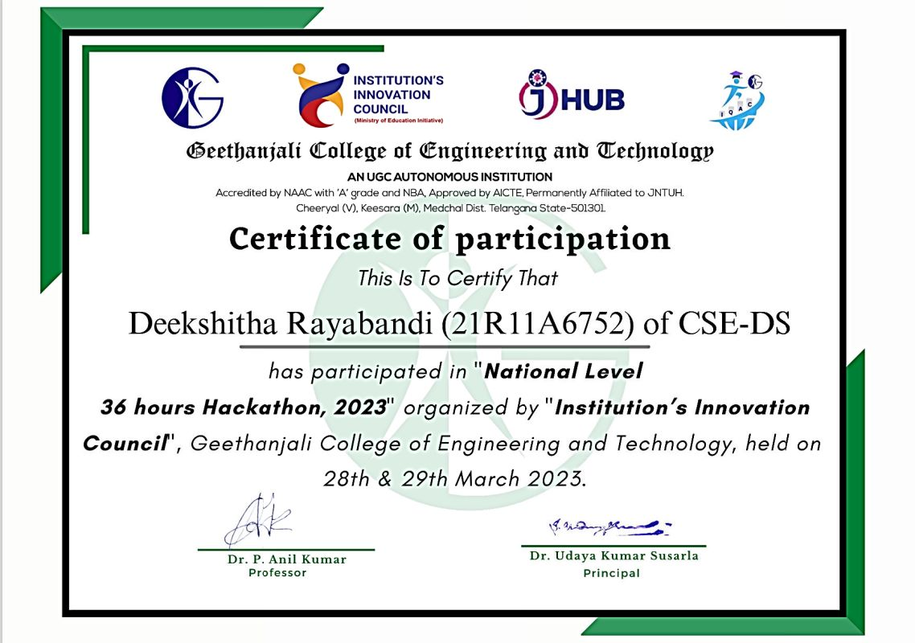
Awards and Recognitions:
We are proud to have been selected in the first startup cohort, among 45 ideas, being run by our college.
Excited to have the opportunity to make a real difference in our community. "Thanks to the guidance and expertise of our mentors, we are confident in our ability to take our startup to the next level and achieve our goals."

Slide 17
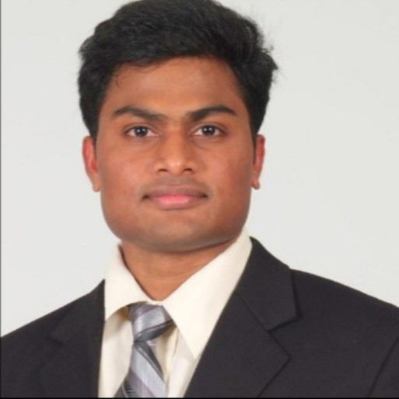
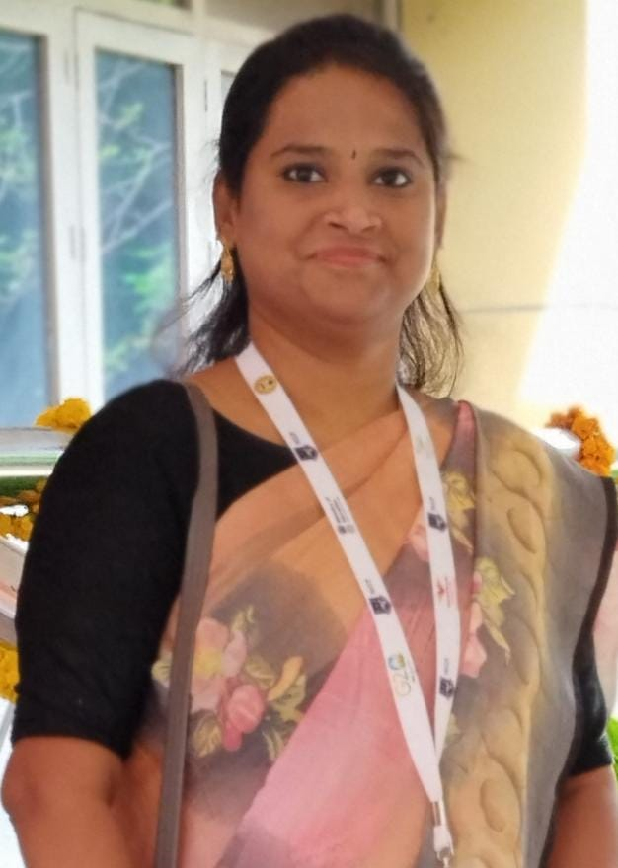
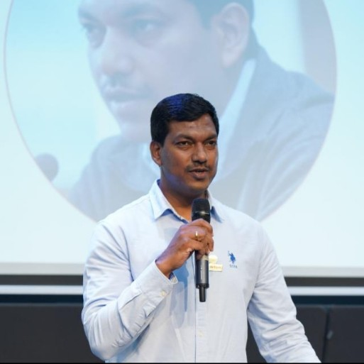
MENTORS & ADVISORS:
Mr.Manoj Kumar Bhadagharvala
Product Development Mentor
Startup Advisor
Dr.Anil Puppala
Managing Director
Vijetha Engineering Industries
Alphonsa
Advisor

Slide 18
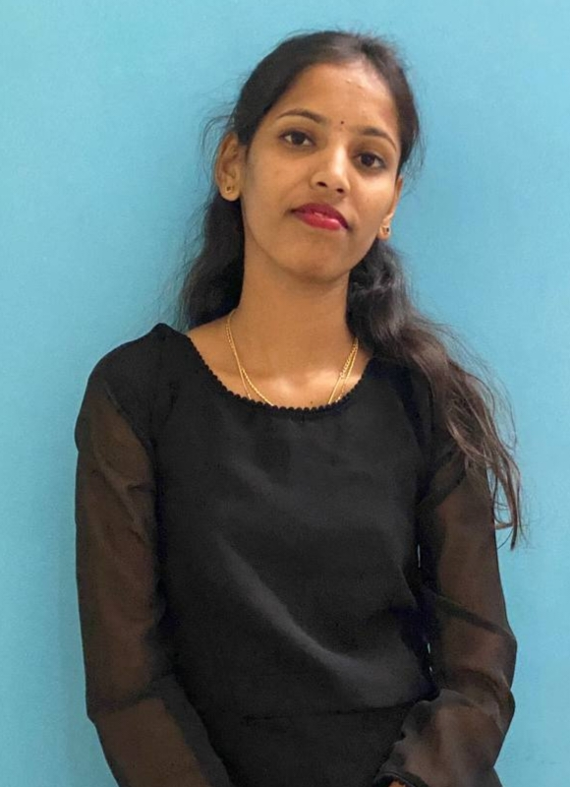
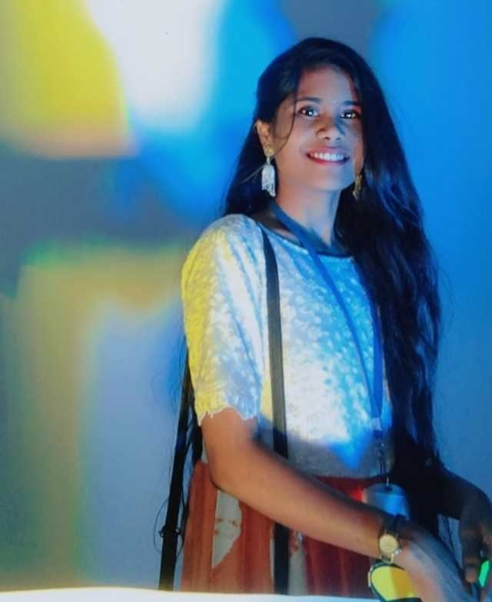
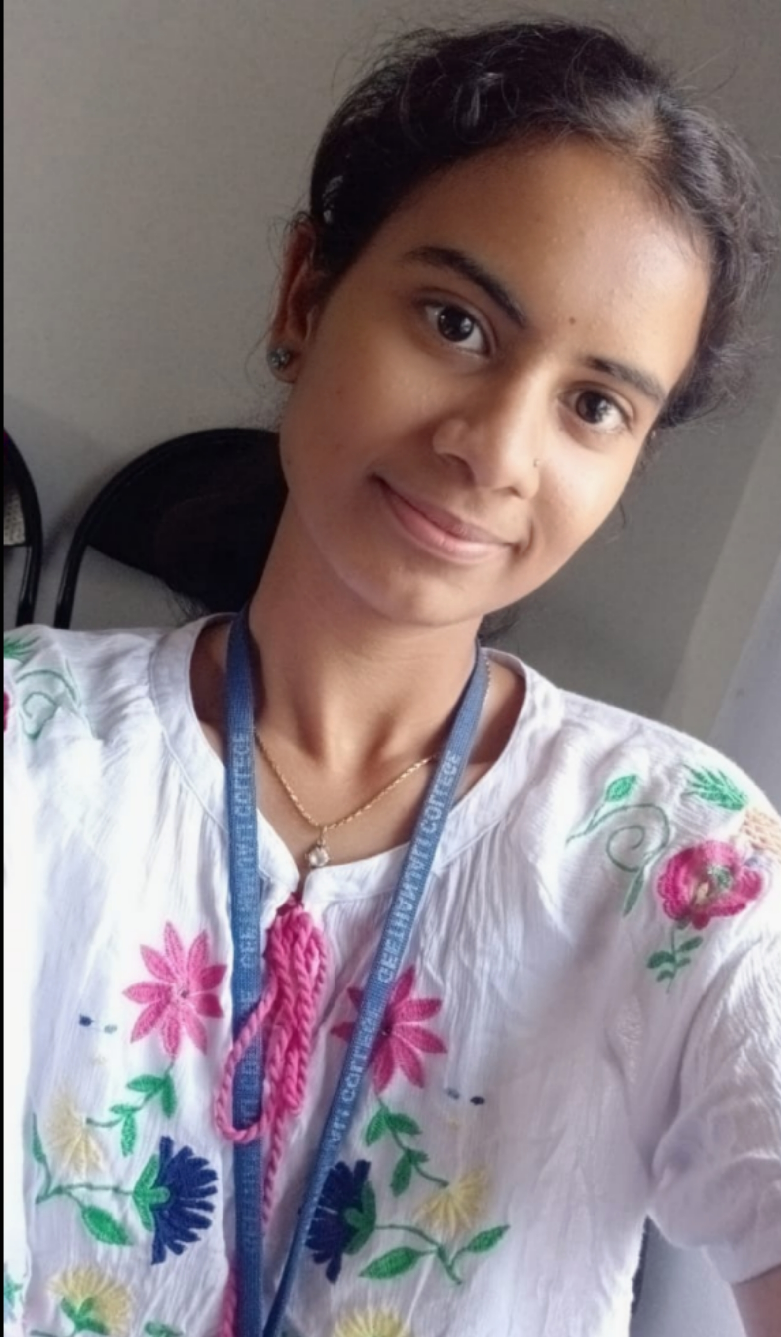
Meet Our Team:
Ch.Meghana
Email:22R15A6203@gcet.edu.in
Pursuing computer science &Engineering in Cyber Security From Geetanjali College Of Engineering and Technology
Phone no:9515145452
I. Akshaya Nandu
Email:21R11A6720@gcet.edu.in
Pursuing computer science &Engineering in Data Science From Geetanjali College Of Engineering and Technology
Phone no:7997537927
R.Deekshitha
Email:21R11A6752@gcet.edu.in
Pursuing computer science &Engineering in Data Science From Geetanjali College Of Engineering and Technology
Phone no:7287998998

